Slide 1
Bias and Expectations

Slide 2
What is Bias
A particular tendency, trend, inclination, feeling, or opinion, especially one that is preconceived or unreasoned
Some synonyms:
Preconception, predilection, partiality, prejudice

Slide 3
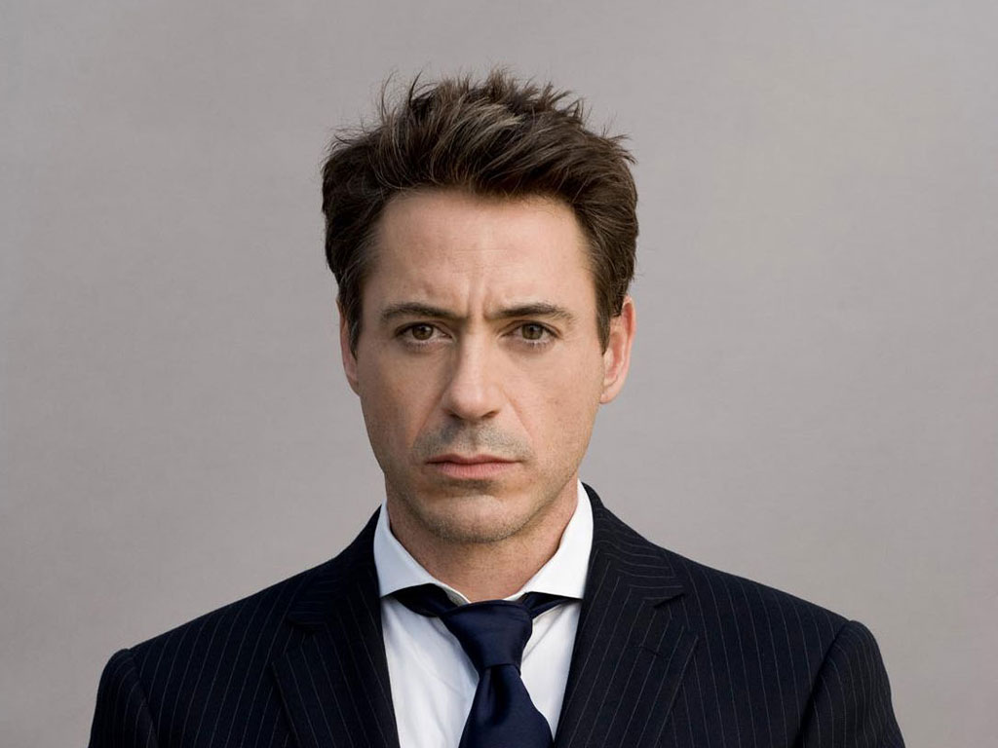
This person served prison time for trespassing in their neighbor’s house and passed out in their neighbors bed
All of this done while he was high on drugs

Slide 4
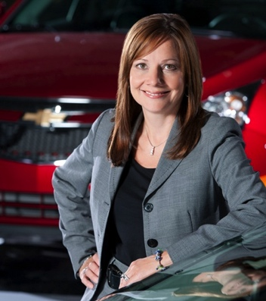
This person is the CEO of one of America’s biggest car companies

Slide 5
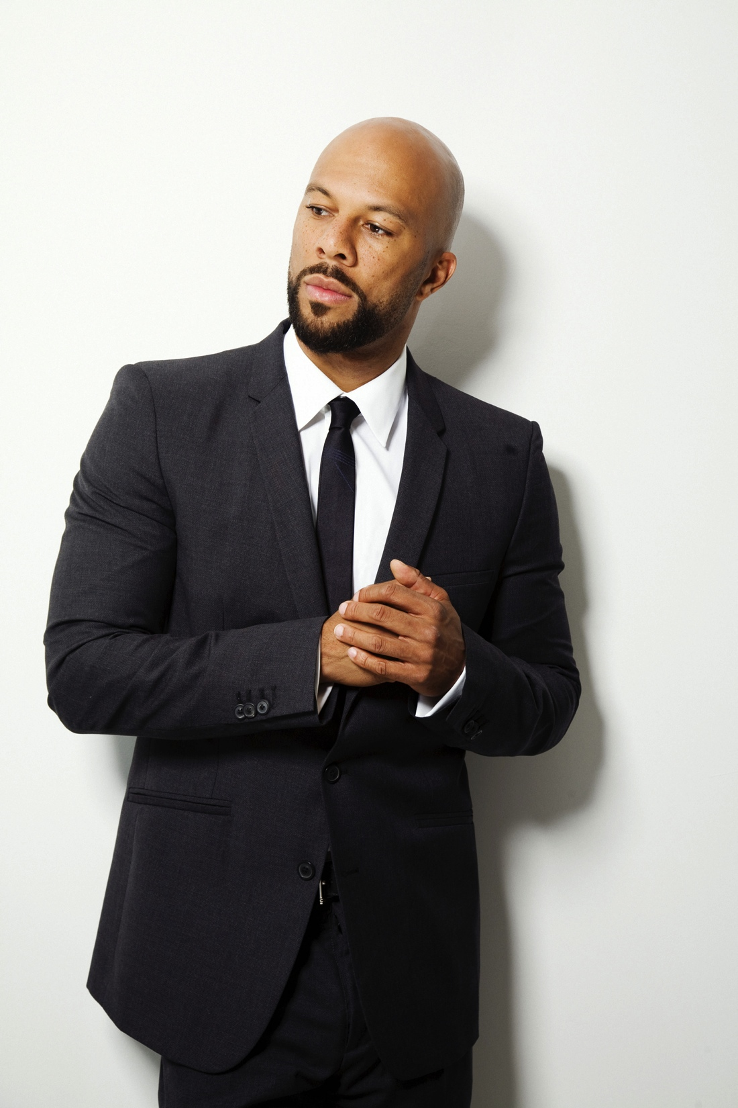
This person grew up on the streets of Chicago and is now in the rap business

Slide 6
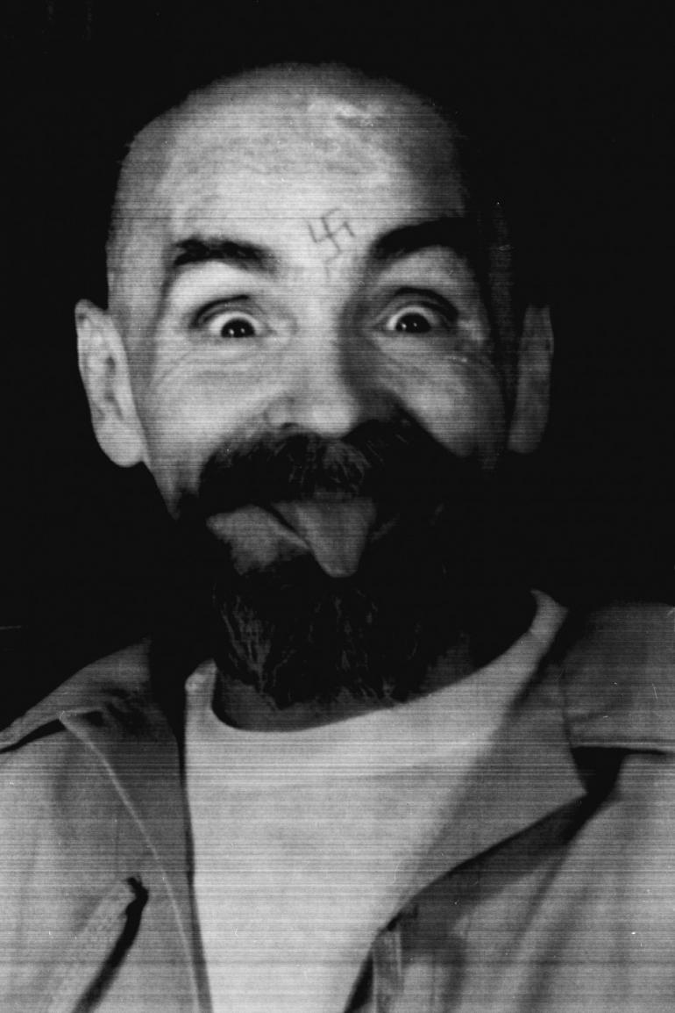
This person wrote folk and rock n’ roll music in the 1960s
The Beach Boys were part of this person’s social circle

Slide 7
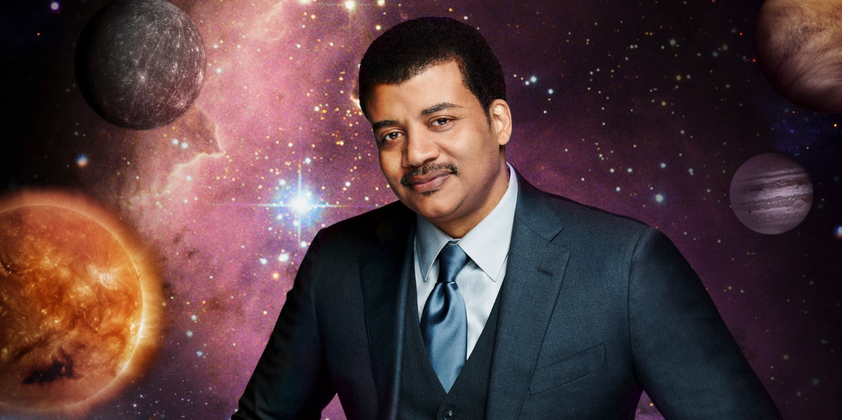
This person is an astrophysicist and scientist
He is also the director of the Hayden planetarium in New York

Slide 8
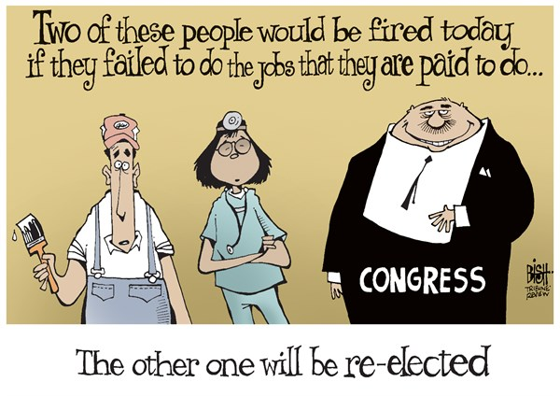

Slide 9
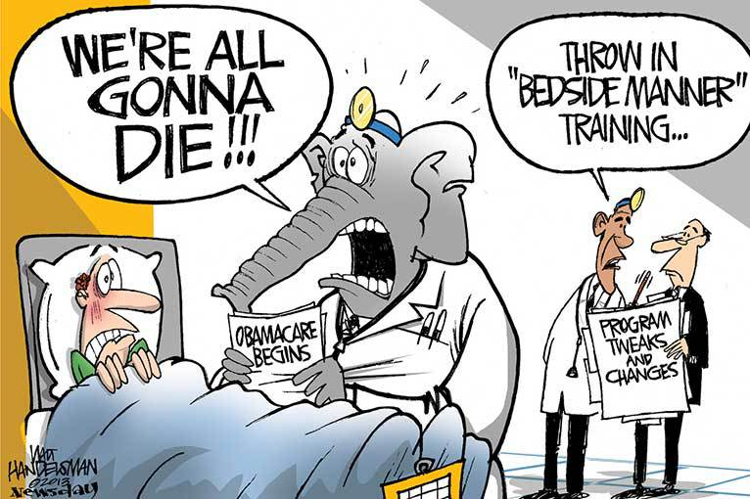

Slide 10
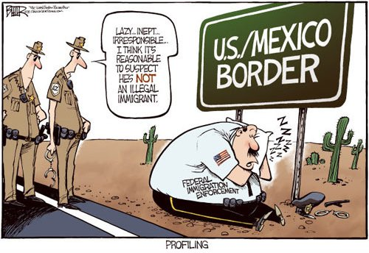

Slide 11
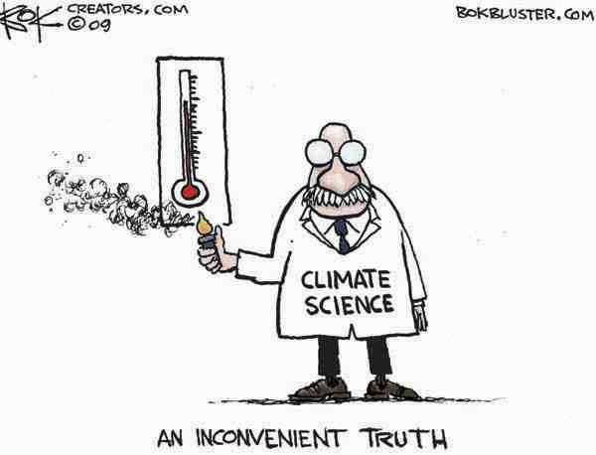

Slide 12
