Slide 1
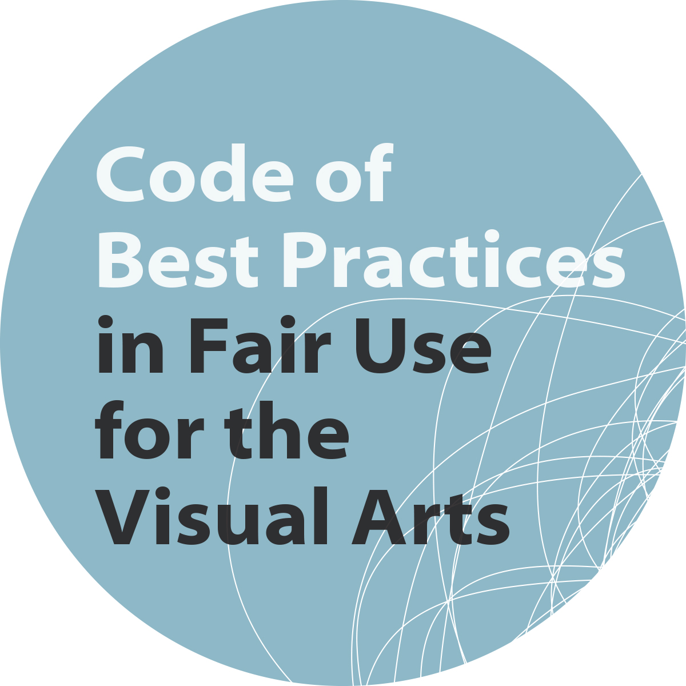
Available at:
collegeart.org/fair-use
cmsimpact.org/fair-use
Funded by the Andrew W. Mellon Foundation
Additional support provided by the Samuel H. Kress Foundation

Slide 2
Code of Best Practices
in Fair Use for the Visual Arts
OVERVIEW
Why fair use is important in the visual arts
Fair use: the basics
Why a code of best practices?
What’s in the CAA code
More support
What you can do

Slide 3
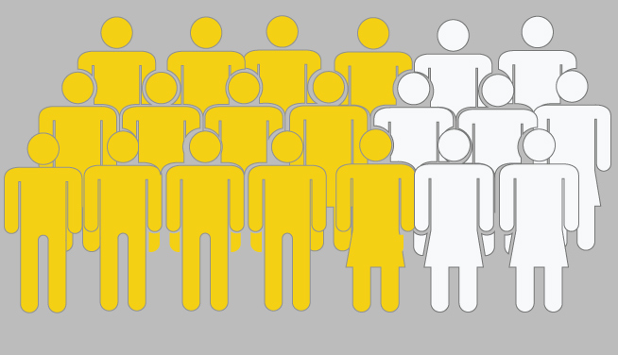
Code of Best Practices
in Fair Use for the Visual Arts
WHY IT MATTERS: 2014 CAA ISSUES REPORT
70% of respondents say they use copyrighted
material in doing their own work
Notes:
Here’s why fair use is important to members of the visual arts community: Most of them use copyrighted material in their work, and sometimes they do not need to ask permission to use it. It’s important in terms of efficiency, finances and most importantly, hewing to the mission of their work that they know when they need to get permission and when they don’t.

Slide 4
Code of Best Practices
in Fair Use for the Visual Arts
Writing about art
Teaching about art
Museum uses
Making art
Organizing documentation
Notes:
Here are five situations in which members of the visual arts community may have fair use needs. And following are some typical questions:

Slide 5
Code of Best Practices
in Fair Use for the Visual Arts
FOR INSTANCE
“I found a suitable image online to illustrate my article. Do I still need a license?”

Slide 6
Code of Best Practices
in Fair Use for the Visual Arts
AND
Can I use some photos I took of an artist’s work on my online course site?”

Slide 7
Code of Best Practices
in Fair Use for the Visual Arts
AND
“I’m making art from found images. Do I need to get permission to use them.”

Slide 8
Code of Best Practices
in Fair Use for the Visual Arts
AND
“Can I use pictures from our exhibition in museum publications?”

Slide 9
Code of Best Practices
in Fair Use for the Visual Arts
AND
“Can we put our archival collection online?”

Slide 10
Code of Best Practices
in Fair Use for the Visual Arts
WHAT IS
FAIR USE?
Notes:
What, then, is the copyright doctrine of fair use?

Slide 11
Code of Best Practices
in Fair Use for the Visual Arts
THE PURPOSE OF
COPYRIGHT
Notes:
To explain fair use, we start with understanding the purpose of copyright. Many people understand copyright as the right to control the use of a work after it’s made. And that’s certainly part of it.

Slide 12
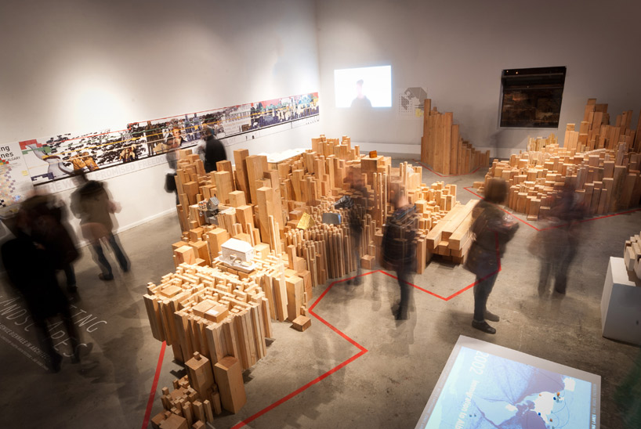
Code of Best Practices
in Fair Use for the Visual Arts
ONE PURPOSE:
TO PROMOTE THE CREATION OF CULTURE
Notes:
But in fact copyright monopoly is only one part of a more general purpose: to promote the creation of culture. The designers of the U.S. constitution seriously considered not having copyright at all, because of their aversion to monopolies, which by design favor the few against the many. But they decided that in some cases, their central goal—encouraging a rich cultural environment for their brand-new country—might be served as well by providing a limited benefit to cultural creators, similar to the one they already had in England (and where, possibly, they might stay if the U.S. offered them nothing!). So today, copyright is part of our Constitution, where it is described as designed to promote “Science and the Useful Arts,” with “Science” being then understood as knowledge generally.

Slide 13
Code of Best Practices
in Fair Use for the Visual Arts
BY
Rewarding creators with limited monopoly
Encouraging new makers to use existing culture
Notes:
Copyright law has two major aspects, which should balance each other, and both of which are designed to provide incentives to makers. There is, of course, the well-known copyrighted monopoly, which continues to be limited today (although much less limited than in the days of the Founders). Then there are the provisions that release new makers from copyright monopoly. In the old days, and especially before 1976, when new legislation vastly expanded copyright monopoly (a process that is ongoing), the most common provisions to encourage new makers to use the created culture around them to make new work was simply the limitation on monopoly. The copyright monopoly when it began was short, it didn’t cover all kinds of work, you had to ask for it and then renew it, and it didn’t apply to the wide variety of follow-on works. All that has changed. So other provisions, most importantly the fair use provision, have risen in importance.

Slide 14
Code of Best Practices
in Fair Use for the Visual Arts
BIGGEST BALANCING FEATURE
FAIR USE
Non-infringing, unauthorized use of copyrighted material—under some circumstances
Notes:
Fair use, which was first asserted in case law in 1841 and became codified in 1976, says that you can use copyrighted material without permission or payment, in some circumstances. Fair use never has to be approved by anyone, and it’s a right that you claim like you do any First Amendment right; you simply do it. If someone challenges you, you will assert your fair use right actively for the first time, and thus it’s known as a “defense,” like the right of self-defense is a defense. But it is just as much a right as any other; waiting to assert it only if you need to doesn’t remove its value as a right.

Slide 15
Code of Best Practices
in Fair Use for the Visual Arts
“FOUR FACTORS”
1. Purpose of the use
2. Kind of work used
3. Amount used
4. Effect on the market
Notes:
The law provides only the most abstract guide to how to interpret fair use; this was deliberate, to ensure that it would be flexible for new creators with new projects and new modes of expression to be able to use it as they needed to. The law says that users should consider four general questions, or “factors,” and also encourages people to think about anything else they mind regard as relevant.

Slide 16
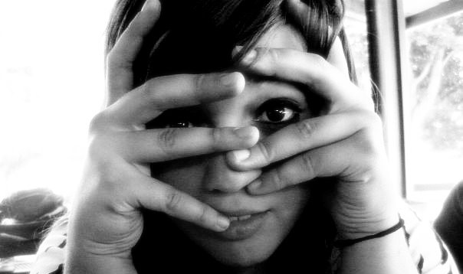



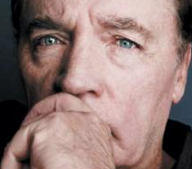

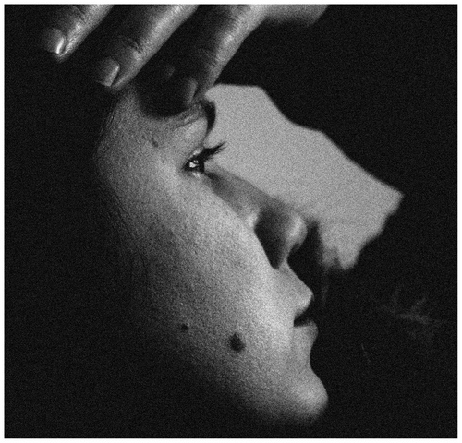

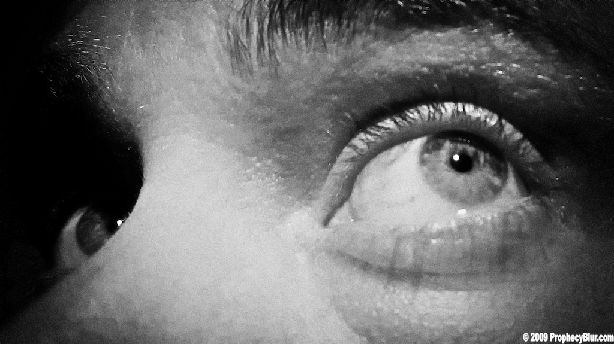


Notes:
In practice, these four factors can be deeply confusing and anxiety-producing for people. They don’t know if they are guessing right about how to interpret those “four factors” in their particular case.

Slide 17
Code of Best Practices
in Fair Use for the Visual Arts
GOOD NEWS:
Judges balance interests in fair use analysis
Supreme Court: Fair use promotes free speech
Judicial interpretation has changed a lot since 1990
Notes:
But fair use has never been more useable than today. Key to its useability has been the work that judges have put into to interpreting it. One of them, Judge Pierre Leval, wrote a very important law review article in 1990, putting the notion of “transformation” at the center of fair use interpretation. He said that the big question judges should pay attention to is whether the use generates new culture or not—whether or not the existing copyrighted material is used differently than the market purpose. This has given judges new language to balance the different interests in their fair use analysis. Judges are acutely aware of the core function of copyright as a collection of incentives to promote the making of new culture. They have been highly favorable to fair users in court. They are aware, as the Supreme Court has asserted, that fair use is a critically important feature of copyright law, protecting it from becoming unconstitutional. That is because fair use allows new makers access to copyrighted work, in an environment in which otherwise copyright monopolies often would lock them out. Then existing copyright holders would be able to dictate the terms of new culture built on today’s culture, and they would be private censors. That would be unconstitutional, because the First Amendment says that the government cannot create laws that interfere with freedom of speech.

Slide 18
Code of Best Practices
in Fair Use for the Visual Arts
JUDGES ASK:
Is the use for a new “transformative purpose”? (in terms of context, audience, added insight, etc.)
Does it employ an appropriate amount to fulfill the transformative purpose?
Notes:
Today, when judges go through the four factors of fair use, they typically come down to asking two basic questions.

Slide 19
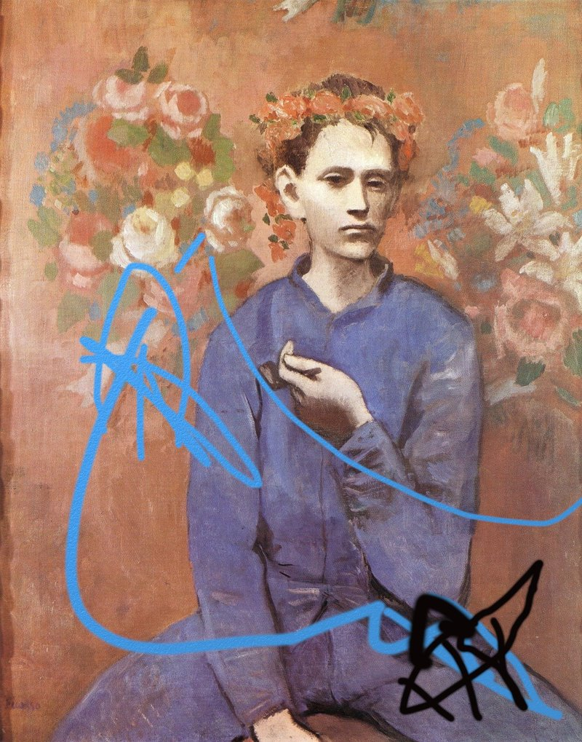
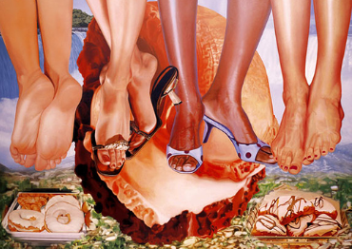
Code of Best Practices
in Fair Use for the Visual Arts
Notes:
New art and art projects may build on existing art, and projects like digital exhibits may use existing art for different purposes than the original market. These are transformative purposes.

Slide 20
Code of Best Practices
in Fair Use for the Visual Arts
JUDGES ALSO CONSIDER:
Custom and practice of individual creative communities…
Custom and practice of individual creative communities…
… especially when well-documented
…especially when well-documented
Notes:
When they are deciding fair use cases, judges inevitably turn to the question of what actually happens in a particular creative community’s practice, to better understand what creative needs are being met by availing oneself of fair use.

Slide 21
Code of Best Practices
in Fair Use for the Visual Arts
WHY DON’T WE EMPLOY FAIR USE MORE FULLY?
Notes:
If judges just love fair use these days, and fair use is a protection against copyright’s unconstitutionality, why aren’t we all using fair use?

Slide 22



Code of Best Practices
in Fair Use for the Visual Arts
PERCEIVED RISK:
Legal trouble
Lost relationships
Bad publicity
Notes:
It’s hard for most of us to make a risk assessment about fair use on our own. And risk can come in many forms. To evaluate risk, you want to know not only what the law says, but what your colleagues will think of you, and whether such behavior is regarded as appropriate by someone like your boss.

Slide 23
Code of Best Practices
in Fair Use for the Visual Arts
WHAT’S THE BIGGEST PROBLEM?
1. Restrictive publishing contracts
2. High licensing fees
3. Difficulty of obtaining clearances
4. None of the above
Notes:
We all face many gatekeepers to our work. People in the visual arts might be going through an editor, a publisher, a gallerist, a thesis advisor, a rights aggregator like ARS or VAGA, or an estate. What do you think the 2014 CAA survey found are the biggest obstacles to employing fair use today?

Slide 24




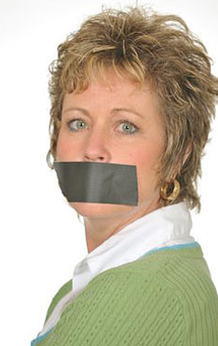
Code of Best Practices
in Fair Use for the Visual Arts
SELF-CENSORSHIP
Notes:
Yes, actually, the most common reason people gave for not employing fair use was their own decision, which they made on the basis of a risk assessment done on their own.

Slide 25
Code of Best Practices
in Fair Use for the Visual Arts
ASSESSING RISK?
CONSIDER BOTH!
Legal risk associated with pursuing mission
Mission risk associated with failing to act
Notes:
Mostly, people were thinking about risk in terms of getting in trouble with the law, an estate, an artist, or their boss. But there are actually two kinds of risks to think about: what happens if you get in trouble for doing something, and what happens to your work, and even your field, if you don’t do something. Too often people weren’t articulating that second part.

Slide 26

Code of Best Practices
in Fair Use for the Visual Arts
CAA REPORT:
1/3 of the visual-arts community have avoided or abandoned work because of copyright concerns
Notes:
Indeed, the 2014 CAA survey found that a third of all repondents had avoided or abandoned work because of their copyright concerns. And we—and possibly even they—will never know what might have been created.

Slide 27
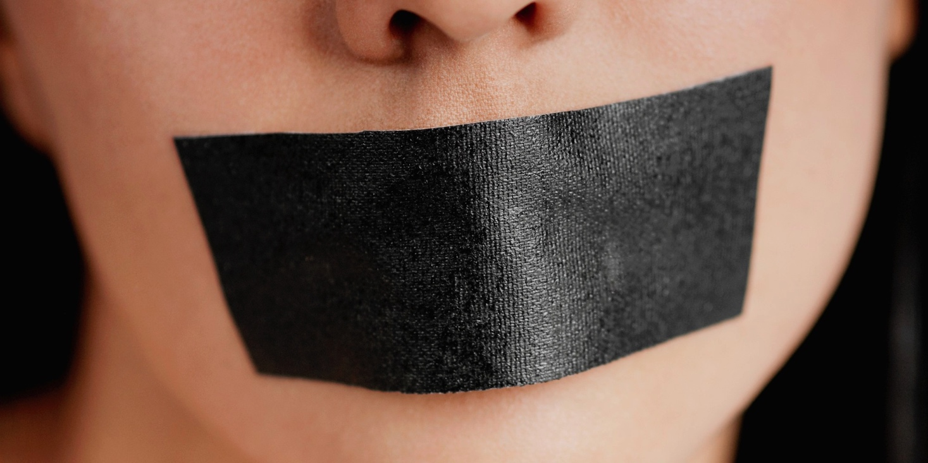
Code of Best Practices
in Fair Use for the Visual Arts
WE HAVE A PROBLEM…
Copyright
Hypercompliance
SELF-CENSORSHIP
Notes:
In the same way that demanding permission or payment can be censoring, so can the individual choice not to make work, which can happen if you make permissions a requirement for doing any work.

Slide 28
Code of Best Practices
in Fair Use for the Visual Arts
EFFECTIVE RISK MANAGEMENT
BEGINS WITH KNOWING YOUR
RIGHTS
Notes:
And this is where we come back to fair use.

Slide 29
Code of Best Practices
in Fair Use for the Visual Arts
CODES OF BEST
PRACTICES
Notes:
Professionals in other fields have learned make better judgments about fair use by understanding the consensus of their peers around employing it. They have written down what they decided, with the help of legal advisors, in codes of best practices in fair use.

Slide 30
Code of Best Practices
in Fair Use for the Visual Arts
CODES, IN FOUR STEPS:
1. Research discovers most common problems
2. Creative community discusses terms of fair use
3. Consensus synthesized
4. Lawyers check work
Notes:
Such codes are usually made, through a membership association, in four steps: First, research to find out what are the most common situations in which people find they could (or can’t) use fair use. Second, convening of small groups throughout the community, to discuss those most common situations, and what the appropriate way to employ fair use should be (including understanding what constitutes “too much” or “over the top”). Then the consensus of those groups is synthesized into a draft code, which is vetted by a legal advisory team.

Slide 31
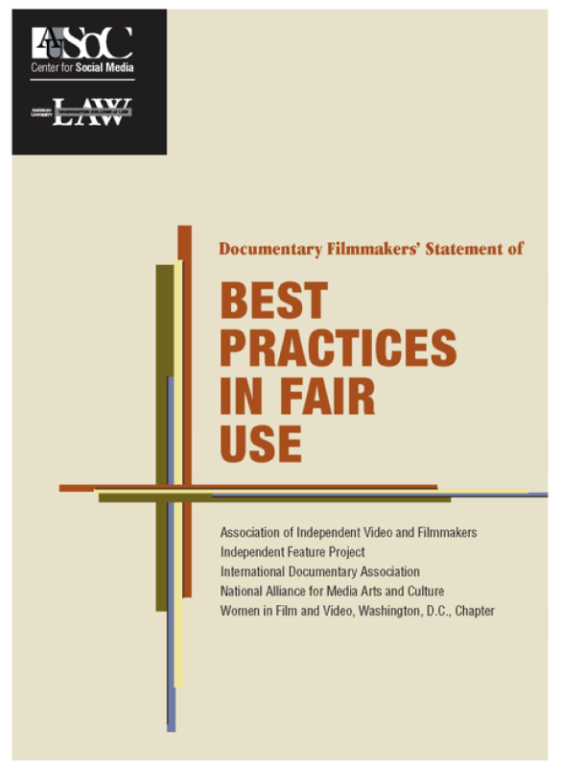
Code of Best Practices
in Fair Use for the Visual Arts
DOCUMENTARY
FIMMAKERS
Notes:
There have been more than 10 codes created in the last decade, including this and others.

Slide 32
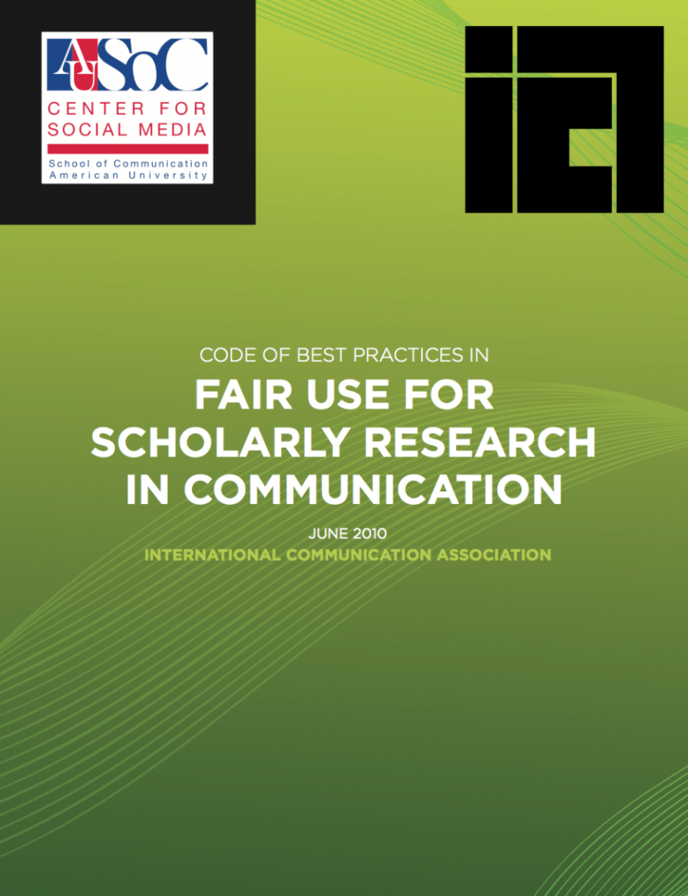
Code of Best Practices
in Fair Use for the Visual Arts
COMMUNICATIONSCHOLARS

Slide 33
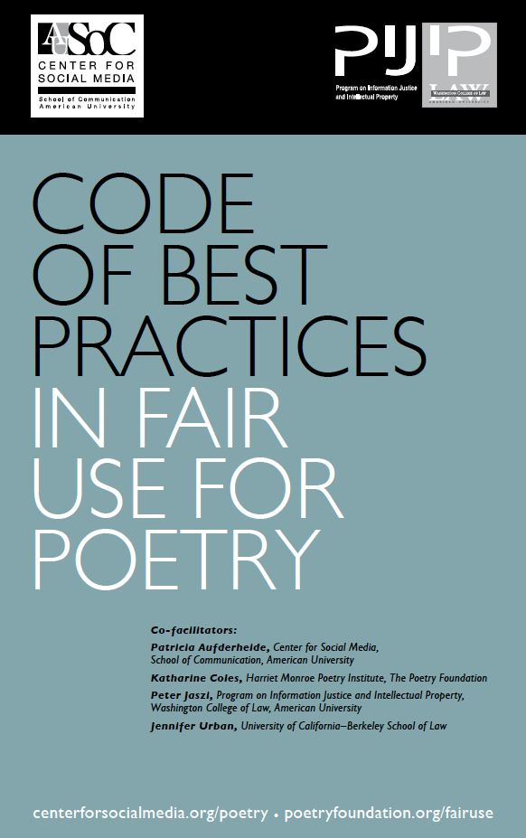
Code of Best Practices
in Fair Use for the Visual Arts
POETS

Slide 34

Code of Best Practices
in Fair Use for the Visual Arts
LIBRARIANS

Slide 35
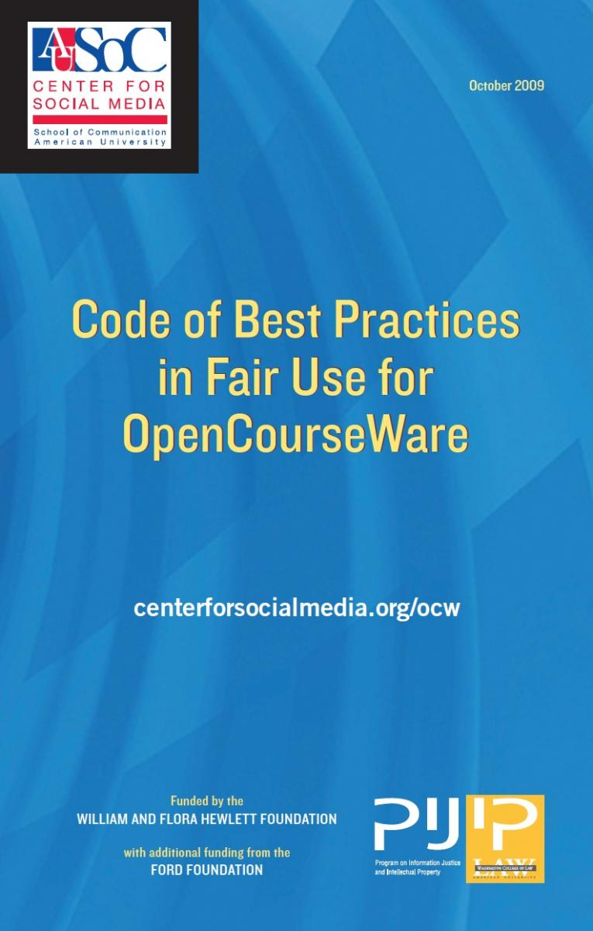
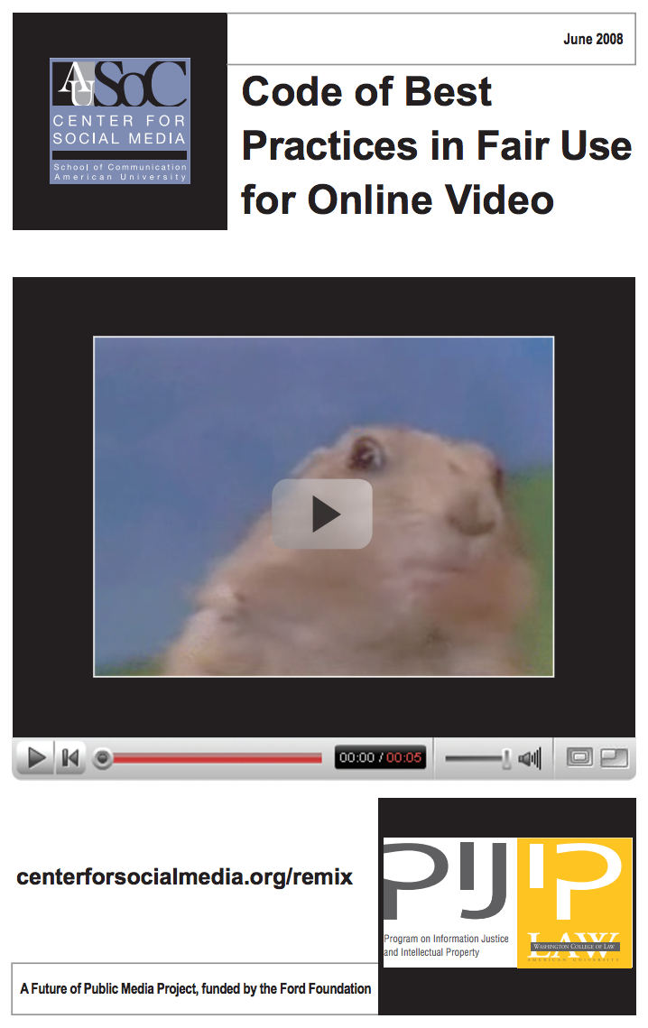
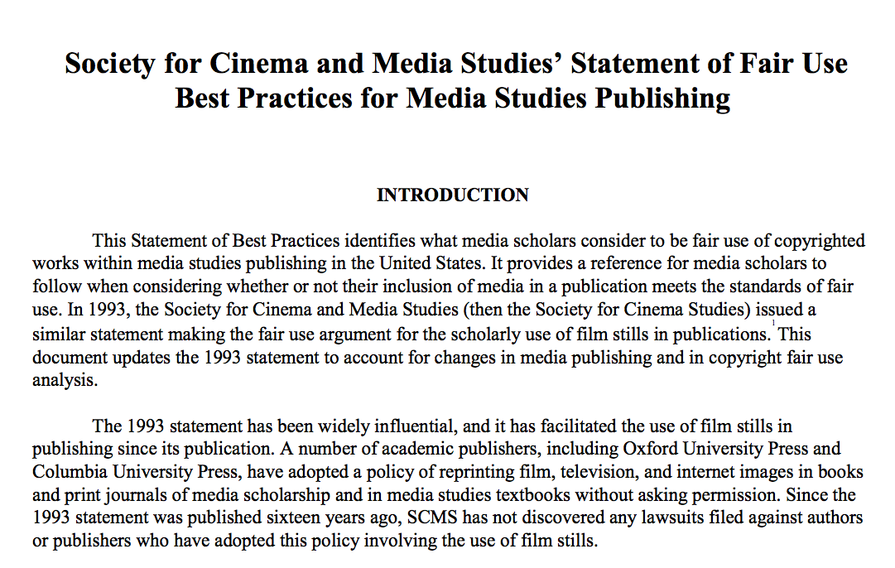
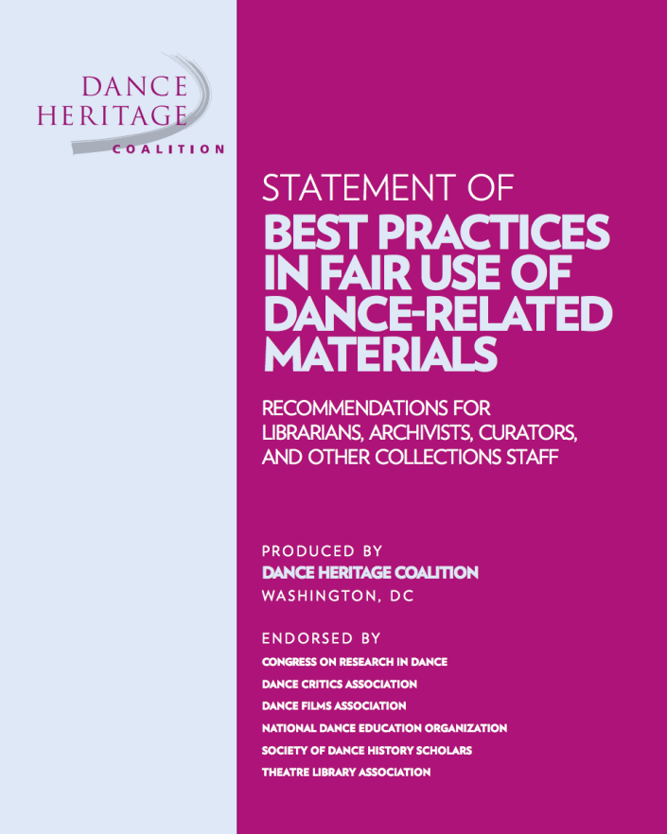
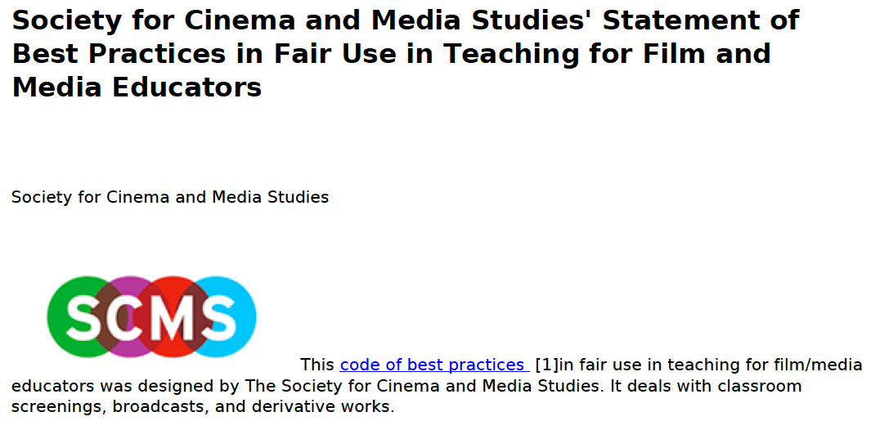
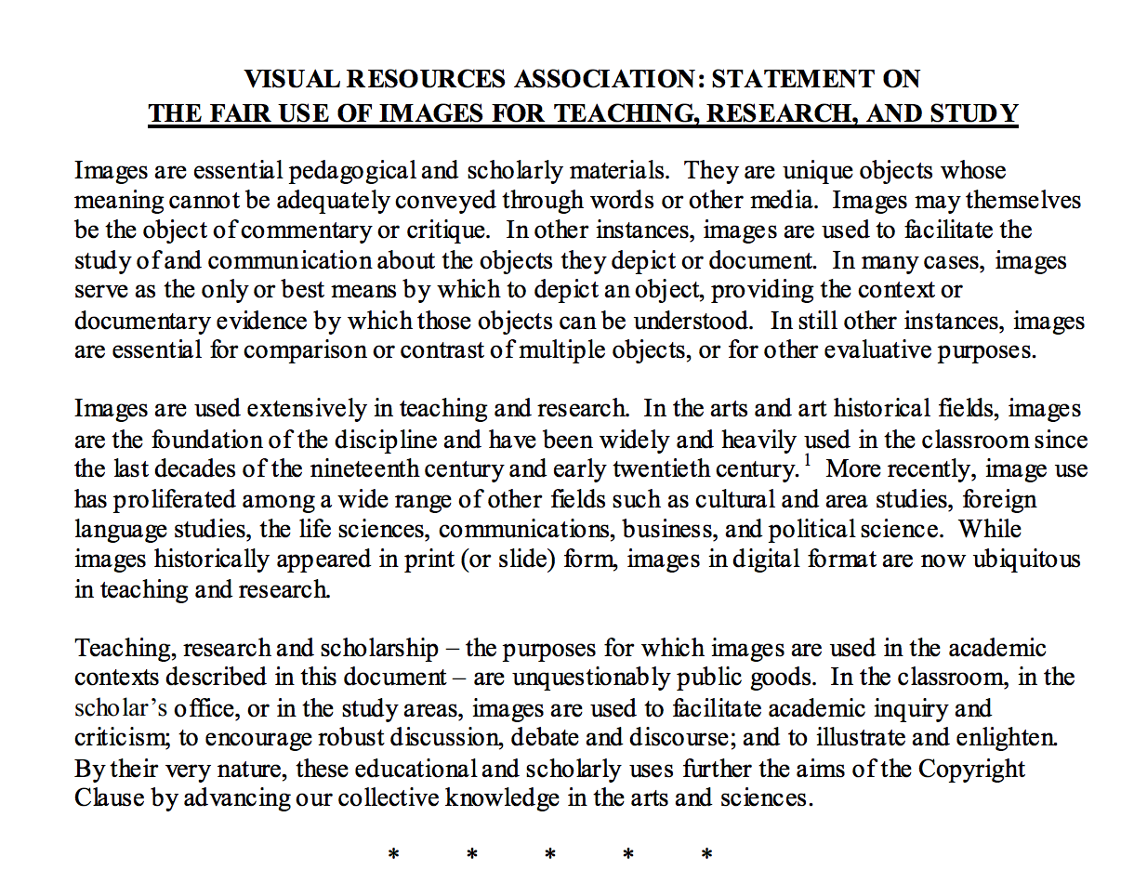
Code of Best Practices
in Fair Use for the Visual Arts
…AND MORE!

Slide 36
Code of Best Practices
in Fair Use for the Visual Arts
NOT LIKE FAIR USE “GUIDELINES”!
A guide to reasoning, not a set of rules
No arbitrary limits or metrics
Based on professional consensus
Not negotiated with copyright holders
Notes:
Here are some basic differences between a code of best practices and the kinds of “guidelines” and “checklists” you can find all over the Internet. Codes don’t tell you what to do; they tell you how your peers think about the most common situations that your field faces, about fair use. They don’t have any of those arbitrary numbers or limits (400 words, seven changes, 30 seconds, and so on) that have grown up around fair use. Instead, they depend on the judgment of your colleagues about what kinds of things you should think about when you’re making a fair use decision, including when you might be going too far. These codes are never negotiated documents; large rights holders, such as estates, aggregators, and media companies, are not in the same profession as yours; you need the judgment of your peers, the colleagues who share the mission to make new culture in some specific way.

Slide 37
Code of Best Practices
in Fair Use for the Visual Arts
INFORMED RISK ASSESSMENT
→ BETTER PRACTICE
EXAMPLES
Documentary filmmakers: Fair use now gets insured
Librarians: Collections digitized
Scholars: New work published
Archivists: Digital exhibits online
Notes:
Here are some ways in which other creative communities were able to get back to doing their work the way they thought was most effective, once they understood their fair use rights.

Slide 38

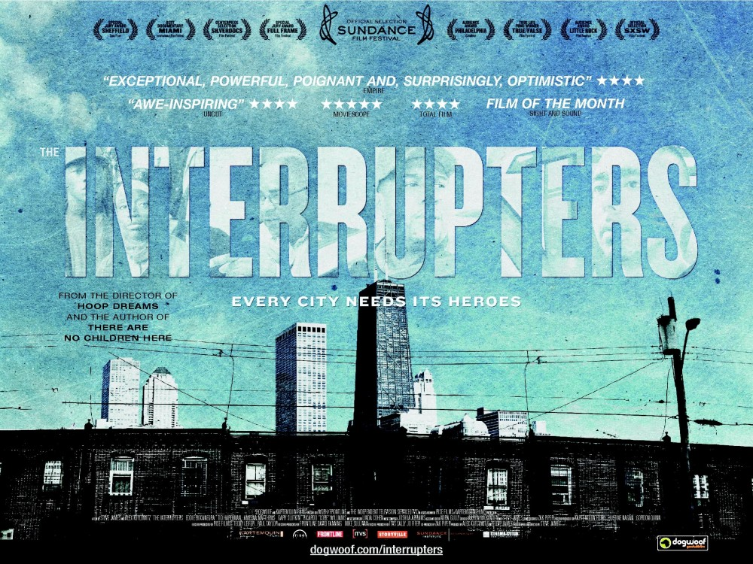


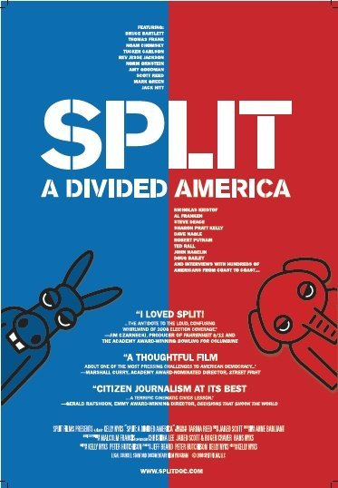
Code of Best Practices
in Fair Use for the Visual Arts
Notes:
Here are some films that liberally employed their fair use rights to make work that could not have been made the same way without them.

Slide 39
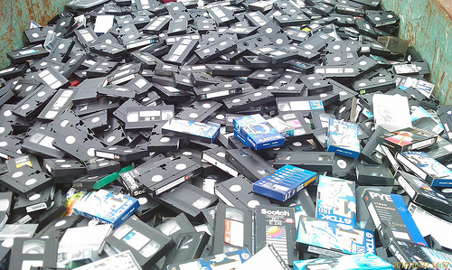
Code of Best Practices
in Fair Use for the Visual Arts
University of Colorado, Boulder:
YES to digital format shifting
Notes:
When librarians got their code, they were able to understand when it was OK to take decaying VHS tapes and make a digital copy to let their patrons use the work. They also believe they shouldn’t, if a reasonably priced DVD was available as a replacement.

Slide 40
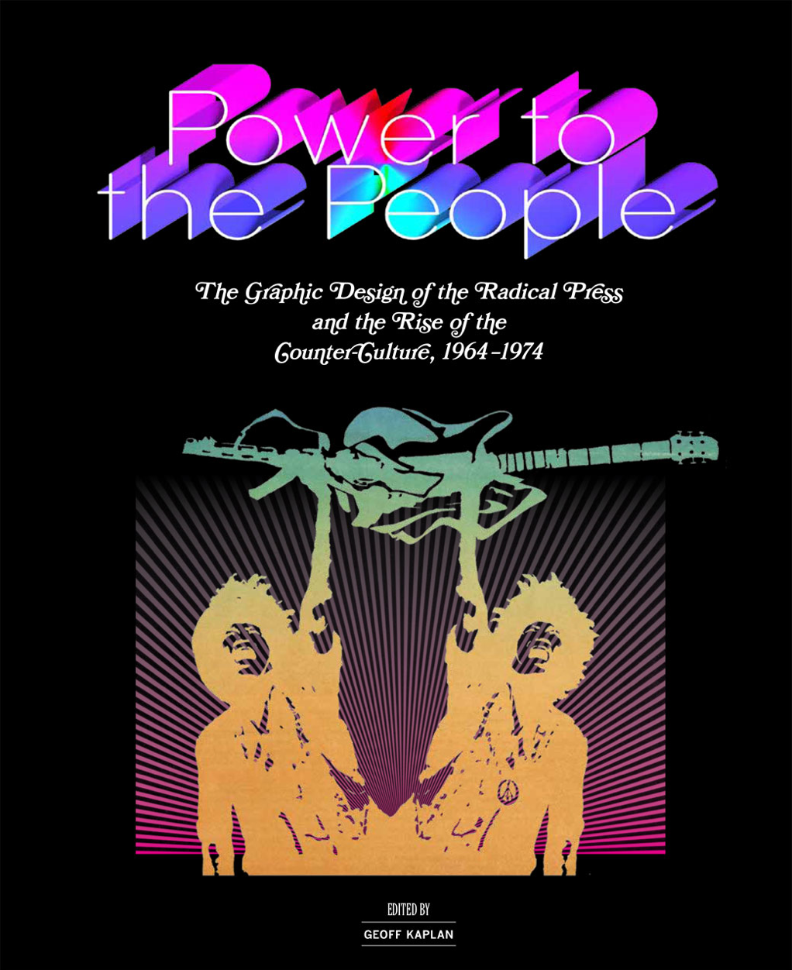
Code of Best Practices
in Fair Use for the Visual Arts
Notes:
Communication scholars and poets have both established codes of best practices, and their work has affected publishing. The University of Chicago Press, for example, has many examples of ephemeral art reproduced under fair use in this book about the graphic design of alternative newspapers in the 60s and 70s. Other publishers who have accepted fair use claims easily include Oxford, Blackwell, and Princeton.

Slide 41
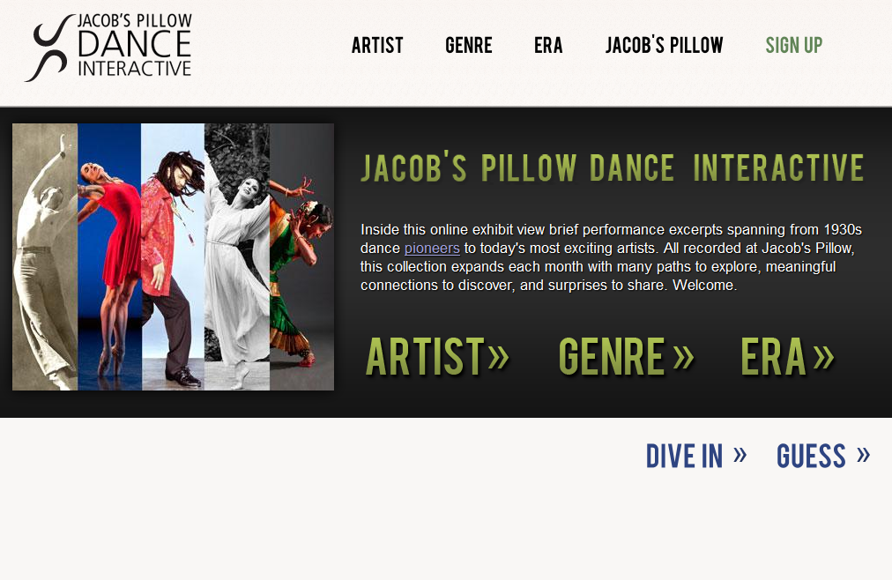
Code of Best Practices
in Fair Use for the Visual Arts
Notes:
Dance archivists were able to showcase important dance history for students everywhere, in this website from Jacob’s Pillow.

Slide 42
Code of Best Practices
in Fair Use for the Visual Arts
DEVELOPING CAA’S CODE
Nationwide fact-finding
10 discussion sessions in 5 cities
Confidential meetings building consensus
Input from CAA Fair Use Task Force
Review by Legal Advisory Committee
Notes:
Here’s how CAA’s code was created.

Slide 43
Code of Best Practices
in Fair Use for the Visual Arts
SITUATIONS
Writing about art
Teaching about art
Museum uses
Making art
Archives online
Notes:
Here are the five most common situations that members of the visual arts community identified, in relation to fair use.

Slide 44
Code of Best Practices
in Fair Use for the Visual Arts
FOR EACH SITUATION IN THE CODE:
Description
Principle
Limitations
Notes:
In the code, each situation has a description of the situation itself, the principle that explains why fair use applies at all, and the limitations on the use to consider carefully.

Slide 45
Code of Best Practices
in Fair Use for the Visual Arts
WHAT YOU CAN DO
Use the Code
Tell a colleague
Tell a student
Tell a publisher
Find an endorser
Notes:
The most important thing you could do, to help the field more efficiently use fair use, is to use the Code yourself. Then, it’s important to spread the word.

Slide 46
Code of Best Practices
in Fair Use for the Visual Arts
MORE INFORMATION:
THE CODES AND MUCH MORE
( VIDEOS! PRESENTATIONS! FAQS! )
cmsimpact.org/fair-use
collegeart.org/fair-use
Notes:
There are plenty of resources to help you teach about fair use, distribute the code electronically, share some of the background legal stuff with gatekeepers who may want to know more specifics, and much more, on these sites.

Slide 47
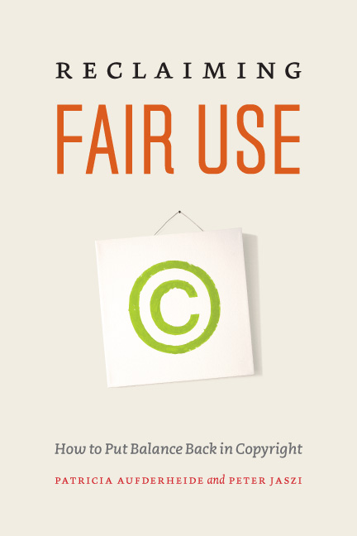
Code of Best Practices
in Fair Use for the Visual Arts
Notes:
If you want to get more background on fair use, there’s always this book, which also describes the making of the best practices codes.

Slide 48
Code of Best Practices
in Fair Use for the Visual Arts
FAIR USE
Practice
Makes
Practice
Notes:
It’s so important to become one of the people who use fair use because fair use’s vitality actually depends on people using it.

Slide 49
Code of Best Practices
in Fair Use for the Visual Arts
Please feel free to share this
presentation in its entirety.
For excerpting, kindly employ
the principles of fair use.

Slide 50
Code of Best Practices
in Fair Use for the Visual Arts
THANK YOU!
CONTACT INFO
nyoffice@collegeart.org

